Slide 1
Design and Development of an AI Prompt Validation and Safety Analyzer Using Context-Free Grammar and Finite Automata
SIMATS ENGINEERING Saveetha Institute of Medical and Technical Sciences Chennai-602105.
Srivarsha M 192371010
Supervisor
Dr K Baskar, Professor
Department of Computer Science and Engineering
SIMATS Engineering
MUPPALLA MADHU RUSHWIKA 192371066

Slide 2

AI Prompt Validator & Safety Analyzer
Artificial Intelligence relies on user prompts, but invalid or unsafe prompts can produce inaccurate or harmful outputs.
This project uses Context-Free Grammar (CFG) to validate prompt structure and Finite Automata (FA) to analyze prompt safety.
Before an AI can give the right answer, it must first receive the right and safe question
The system ensures that only well-formed and safe prompts are forwarded to the AI model for processing

Slide 3


Problem & Motivation
Key Issues
Natural-language prompts are often incomplete, ambiguous, or ungrammatical.
Unsafe or malicious prompts can produce harmful outputs or security risks.
Processing invalid prompts wastes compute and reduces model reliability.
Goal: filter and improve prompts before they reach the AI model.

Slide 4
System Goals
Grammar Safety
Security
Enforce syntactic correctness via CFG parsing.
Detect and block harmful intent with DFA-based matching.
Efficiency
Explainability
Reduce wasted computation by rejecting invalid prompts early.
Produce human-readable validation feedback for users.

Slide 5
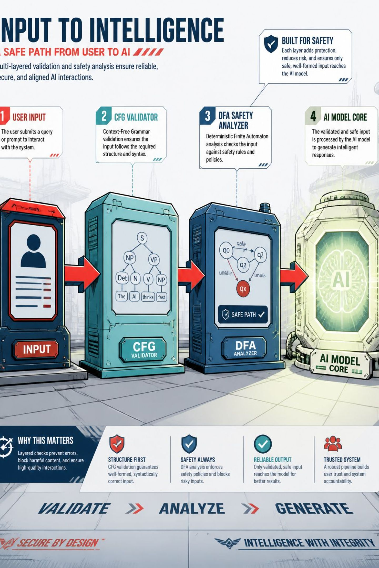
High-level Architecture
Pipeline: User → CFG Prompt Validator → If valid → DFA Safety Analyzer → If safe → Language Model. Immediate, actionable feedback is returned for invalid or unsafe prompts.

Slide 6

Module 1 — CFG Prompt Validation
Responsibilities
Validates Prompt Structure – Checks whether the user's prompt follows predefined CFG grammar rules.
Tokenizes the Prompt – Splits the prompt into individual words (tokens) for analysis.
Parses Using CFG – Compares the tokens with grammar production rules to verify syntax.
Accepts or Rejects the Prompt – Valid prompts are forwarded to the next module, while invalid prompts are rejected with an error message.
Improves AI Input Quality – Ensures only well-formed prompts proceed to the safety analysis module, improving reliability and reducing invalid inputs.

Slide 7
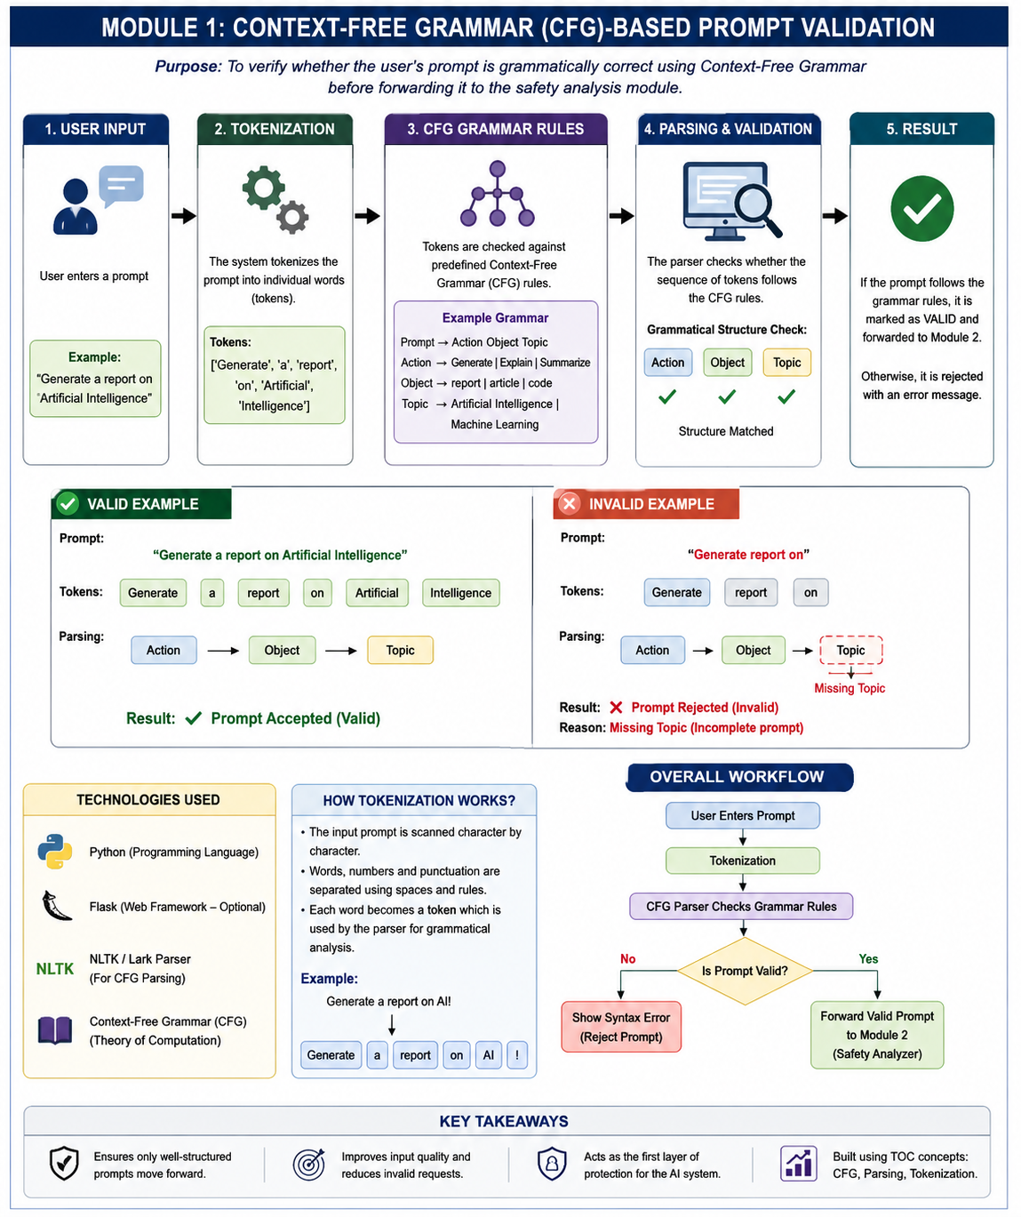

Slide 8
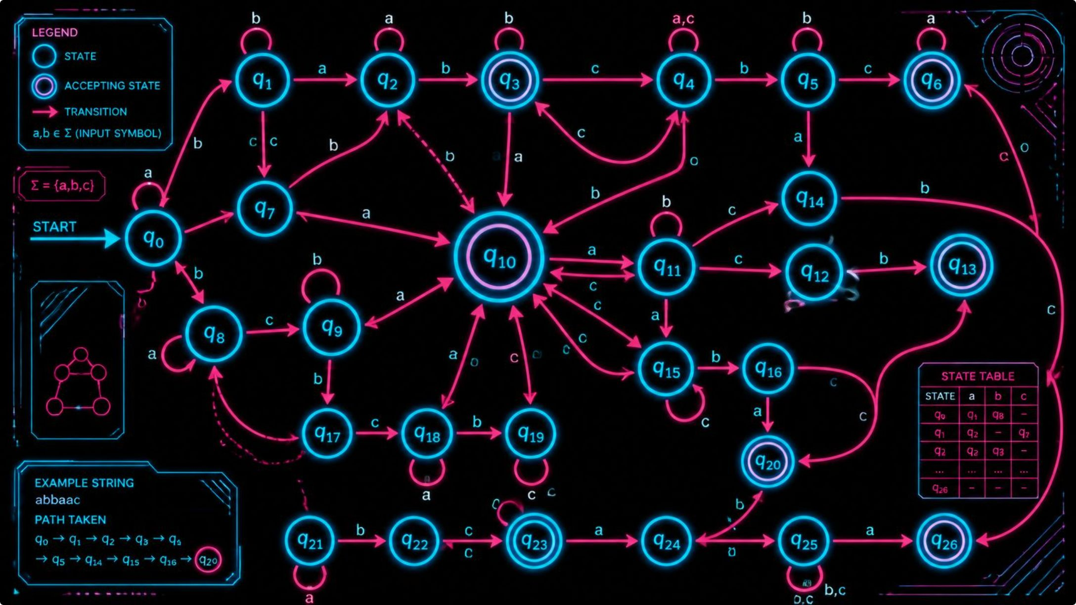

Module 2 — DFA Safety Analyzer
Design
Deterministic automata perform fast keyword and pattern detection.
State transitions model escalating suspicion (safe → suspicious → unsafe accept).
Lists of harmful tokens (e.g., hack, exploit, malware, password) mapped to accept states.
DFA is intentionally conservative: flagged prompts trigger manual review or blocking depending on policy.

Slide 9
Algorithms — Implementation Details
CFG Implementation
DFA Implementation
Integration
Python, recursive-descent parser using NLTK/PyParsing. Produces parse trees and human-readable error tokens.
Keyword automata implemented as state machine with linear-time scanning and configurable keyword sets. Integrates with a policy layer for severity thresholds.
Flask REST API: validation endpoints return JSON {status, reason, suggestions, parseTree}. Secure logging and audit trail included.

Slide 10
Evaluation — Sample Results & Metrics
Key metrics to collect: validation pass rate, false positives/negatives for safety detection, average latency per module, compute saved by early rejection. These guide tuning of CFG breadth and DFA sensitivity.
Prompt
Outcome
Explain AI basics
Valid · Safe · Accepted
Generate report of
Invalid · Syntax error: missing object
Hack WiFi password
Valid · Unsafe · Blocked
Malware creation steps
Valid · Unsafe · Blocked

Slide 11
Conclusions, Limitations & Future Work
Conclusions
Limitations
Future Work
Combining CFG and DFA enforces syntactic quality and filters harmful prompts, improving reliability and security of downstream models.
CFGs are brittle for free-form language; DFAs rely on keyword lists and can miss contextual intent or adversarial phrasing.
Integrate statistical NLP and ML classifiers for semantic safety, expand multilingual CFGs, add context-aware policies, and evaluate at scale with user studies.
References: Hopcroft et al., Sipser; NLTK, Python, Flask; prompt engineering guidelines. (Full citations available on request.)

